Slide 1
Date : 2013/03/18
Author : Jeffrey Pound, Alexander K. Hudek, Ihab F. Ilyas,
Grant Weddell
Source : CIKM’12
Speaker : Er-Gang Liu
Advisor : Prof. Jia-Ling Koh

Slide 2
Outline
Introduction
Query Segmentation & Annotation
Baseline term classification
CRF feature design
Structuring Annotated Queries
From Structures to KB Interpretations
Experiment
Conclusion

Slide 3
Introduction - Motivation
Query understanding is a broad phrase used to describe many techniques applied to keyword queries.
To represent the underlying information need in a way that a search system can exploit.
EX：Finding entities of type song that are created by an entity named “jimi hendrix”.
the person named “jimi hendrix” who is known to have written songs,
a song named “jimi hendrix”
Notes:
即便已經有外部的 Knowledge 輔助. 但所對應到的還是有很多意思
哪一個是使用者真正想要 查詢意圖

Slide 4
Introduction - Motivation
The difficulty in mapping a keyword query to a formal interpretation lies in the inherent ambiguity in keyword queries
Many possible mappings query terms can have over very large reference data collections.
For example, the term “hendrix” matches 68 data items in our data set, and the term “songs” matches 4,219 items, and the term “by” matches 7,179 items
Notes:
即便已經有外部的 Knowledge 輔助. 但所對應到的還是有很多意思
哪一個是使用者真正想要 查詢意圖

Slide 5
Introduction - Overview
The goal of semantic query understanding is to compute a formal interpretation of an ambiguous information need
The main focus of this paper is on the first two steps, building on existing methods to address the final two steps

Slide 6
Outline
Introduction
Query Segmentation & Annotation
Baseline term classification
CRF feature design
Structuring Annotated Queries
From Structures to KB Interpretations
Experiment
Conclusion

Slide 7
Query Segmentation & Annotation
Semantic constructs
An algorithm that annotates keyword queries with semantic constructs must solve both the segmentation problem and the annotation problem.
Baseline term classification
CRF feature design

Slide 8
Outline
Introduction
Query Segmentation & Annotation
Baseline term classification
CRF feature design
Structuring Annotated Queries
From Structures to KB Interpretations
Experiment
Conclusion

Slide 9
Baseline – term classification
Segment the query by joining any adjacent terms sharing the same semantic construct ( )
EX：$"songs":type "\text{by}":rel "jimi":ent "hendrix":ent$
$"songs":type "\text{by}":rel "jimi hendrix":ent$
Aims to exploit the relationship between part-of-speech tags and semantic constructs by using a term's part-of-speech as a proxy for the term.
Modeling an annotated query log as set of triples L = . (Yahoo! Academic Relations. L13 - Yahoo! Search Query Tiny Sample. )
Notes:
%%L13 - Yahoo! Search Query Tiny Sample (41 K)
This dataset contains a random sample of 4496 queries posted to Yahoo's US search engine in January, 2009.
For privacy reasons, the query set contains only queries that have been asked by at least three different users and contain only letters of the English alphabet, sequences of numbers not longer than four numbers and punctuation characters.
The query set does not contain user information nor does it preserve temporal aspects of the query log.
Total size for this dataset is 41K.

Slide 10
Baseline – term classification
Trying a technique that directly classifies terms independently with semantic constructs.
$$\frac{σ\left(songs\right)=type}{π\left(songs\right)=Plural noun}$$
$$= \frac{32}{50} =68 \%$$
$\operatorname{Pr}\left(type\right| Plural noun)=$
$$\frac{σ\left(by\right)=rel}{π\left(by\right)=Prepostion}$$
$$= \frac{55}{111} =55.6 \%$$
$\operatorname{Pr}\left(rel\right| Prepostion)=$
$$\frac{σ\left(jimi\right)=ent}{π\left(jimi\right)=Proper noun}$$
$$= \frac{99}{100} =99 \%$$
$\operatorname{Pr}\left(ent\right| Proper noun)=$
$$\frac{σ\left(hendrix\right)=ent}{π\left(hendrix\right)=Proper noun}$$
$$= \frac{99}{100} =99 \%$$
$\operatorname{Pr}\left(ent\right| Proper noun)=$
$\operatorname{Pr}\left("songs":type "by":rel "jimi hendrix":ent \right| songs by jimi hendrix)$
$$=0.68 ∗0.556 ∗0.99$$

Slide 11
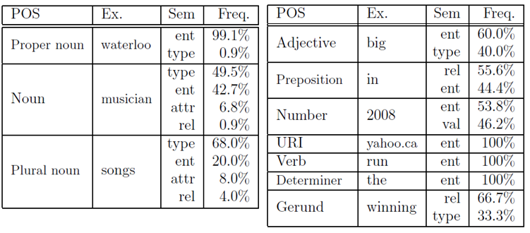
Baseline – term classification

Slide 12
Outline
Introduction
Query Segmentation & Annotation
Baseline term classification
CRF feature design
Structuring Annotated Queries
From Structures to KB Interpretations
Experiment
Conclusion

Slide 13
CRF model
Paper‘s approach to annotating queries exploits
Query terms
POS tags
Sequential relationships between terms and tags
Basing our CRF model on the design for noun-phrase detection.
Labeling each multi-term phrase in the training data with the begin and continue labels corresponding the phrase's semantic construct.

Slide 14
CRF model
For input position xi corresponding to query term qi, we define a feature vector containing the following features:
All query terms and POS tags in a size five window around position xi;
All query term bigrams in a size three window;
All POS tag bigrams in a size five window;
All POS tag trigrams in a size five window.
$$Query : songs by jimi hendrix$$
$$POS Tags : Plural noun , Prepostion , Plural noun , Plural noun$$

Slide 15
Outline
Introduction
Query Segmentation & Annotation
Baseline term classification
CRF feature design
Structuring Annotated Queries
From Structures to KB Interpretations
Experiment
Conclusion

Slide 16
Structuring Annotated Queries
Using the semantic summary as a high level representation of the annotated query.
Directly estimate Pr(T | AQ) from labeled training examples in our query log from the definition of conditional probabilities
$$= \frac{11}{86} =12.8 \%$$

Slide 17
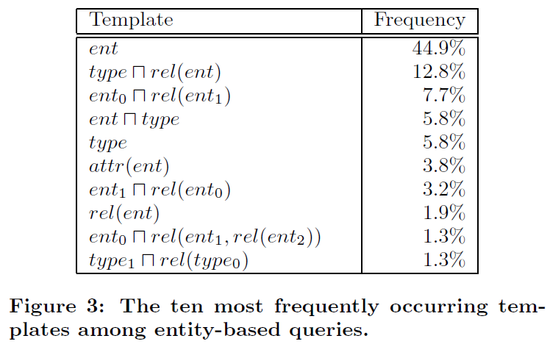
Structuring Annotated Queries

Slide 18
Outline
Introduction
Query Segmentation & Annotation
Baseline term classification
CRF feature design
Structuring Annotated Queries
From Structures to KB Interpretations
Experiment
Conclusion

Slide 19
From Structures to KB Interpretations
This type of expression is called a structured keyword query, and methods to map these expressions into Web knowledge bases.
Given a structured keyword query SKQ, the KB mapping system will return the most probable (or the top-k most probable) concept search query
“Expressive and flexible access to web-extracted data: a keyword-based structured query language.” [ J.Pound et. al , SIGMOD’10]

Slide 20
From Structures to KB Interpretations
The goal is to approximate the probability distribution.
Given a keyword query Q, the concept search query C representing the intent of Q is estimated as:
Probability of concept search query
Probability of a structured template
Probability of an annotated query
$\operatorname{Pr}\left(type∩rel\left(ent\right) \right|<type ,rel ,ent>) ∗$
$\operatorname{Pr}\left(<type , rel ,ent> \right|"songs by jimi hendrix>)$
$=Pr\left(type∩rel\left(ent\right) \right|<type ,rel ,ent>) ∗$

Slide 21
Outline
Introduction
Query Segmentation & Annotation
Baseline term classification
CRF feature design
Structuring Annotated Queries
From Structures to KB Interpretations
Experiment
Conclusion

Slide 22
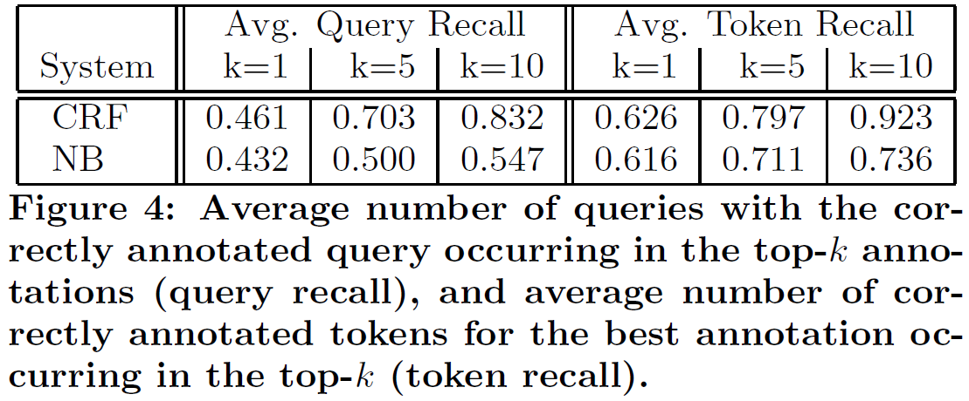
Experiment

Slide 23
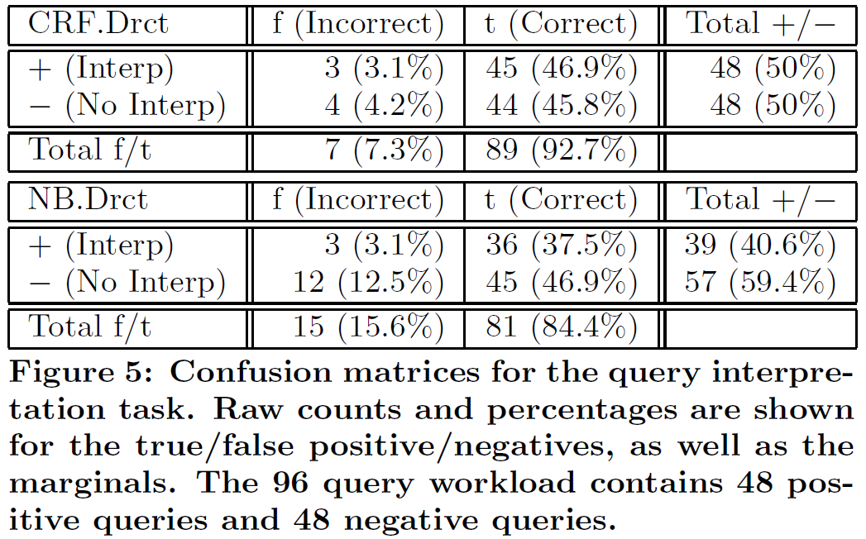
Experiment

Slide 24
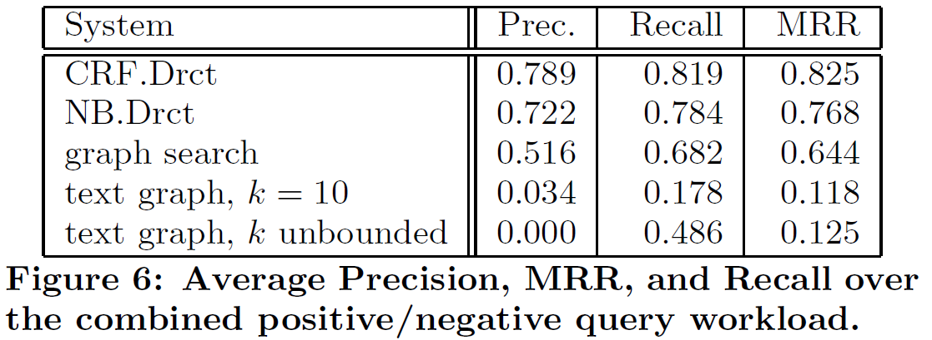
Experiment

Slide 25
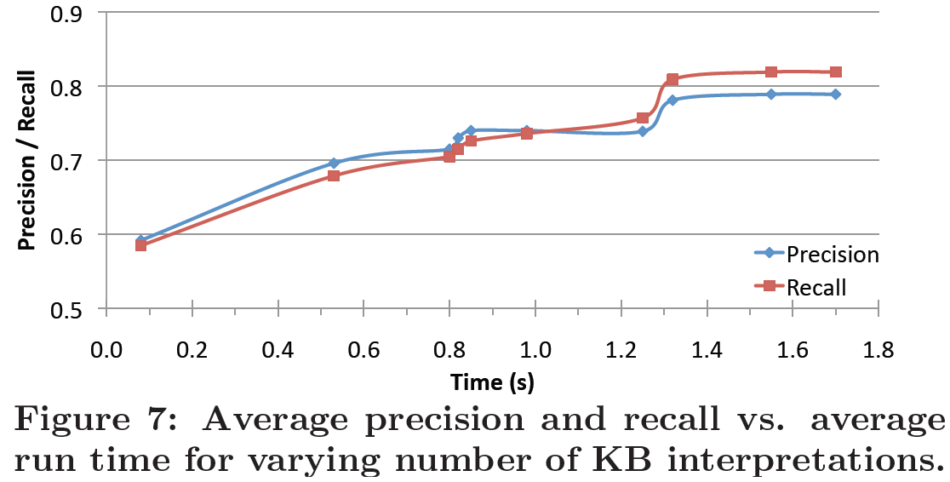
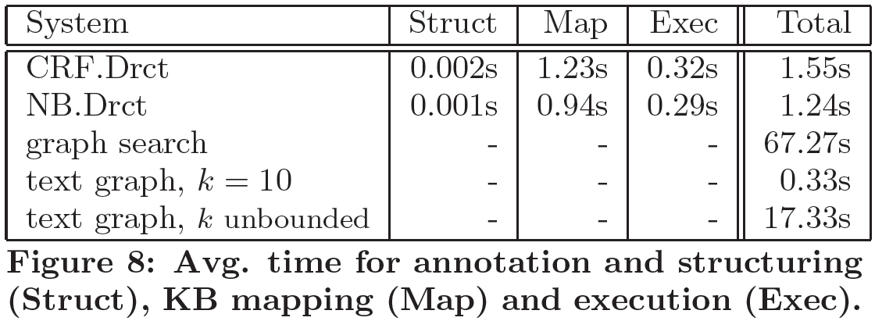
Experiment

Slide 26
Outline
Introduction
Query Segmentation & Annotation
Baseline term classification
CRF feature design
Structuring Annotated Queries
From Structures to KB Interpretations
Experiment
Conclusion

Slide 27
Conclusion
This paper propose a novel method for interpreting keyword queries over Web knowledge bases that computes probable semantic structures based on a statistical model learned from real user queries, and maps them into a knowledge base.
Showing an encoding of the semantic annotation problem as a parameter estimation problem for a conditional random field(CRF) .
Proposing a method of structuring annotated queries that uses a high level representation of both keyword queries and the target knowledge base query structure.

